Slide 1

Document Scanner and PDf generator using Cloud Platform
IT445 – SGP IV
DIRGH JANI(17IT035)
Guided By - Prof. Priyanka patel

Slide 2
OUTLINE
Abstract
Architectural Diagram of project
Prerequisites
Front-end Details
Back-end Details
Services used
Status of Development
Snapshots

Slide 3
Abstract
The project gives you a production ready document scanning application. It allows users to manage projects, upload images, and generate a PDF from detected text. The sample can be used as a template for building expense tracking applications, handling forms and legal documents, or for digitizing books and notes.

Slide 4
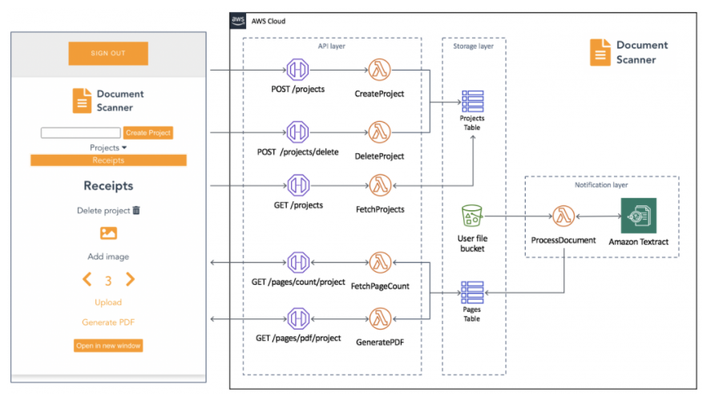
Architectural Diagram of project

Slide 5
Prerequisites
Node.js and npm installed on computer
An AWS Account

Slide 6
The solution consist of two parts
Front-end Application
Serverless Back-end

Slide 7
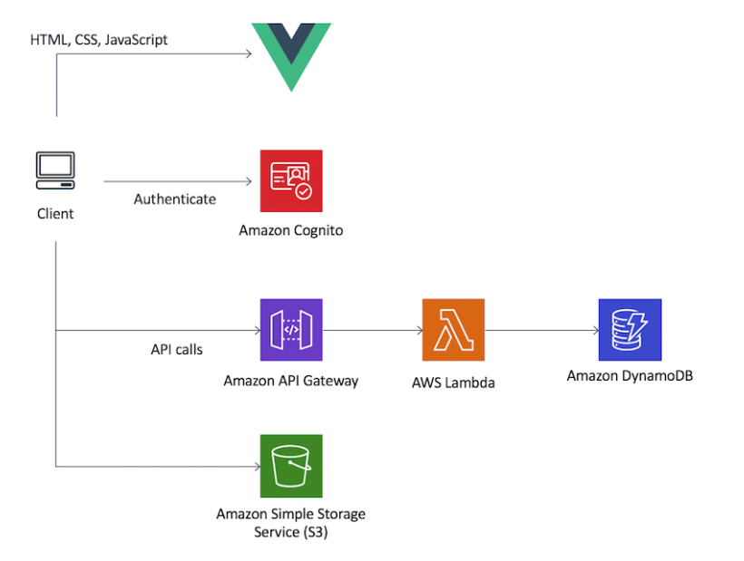
Front-end Application
The frontend application
is written in Vue.js
and uses the Amplify Framework.

Slide 8
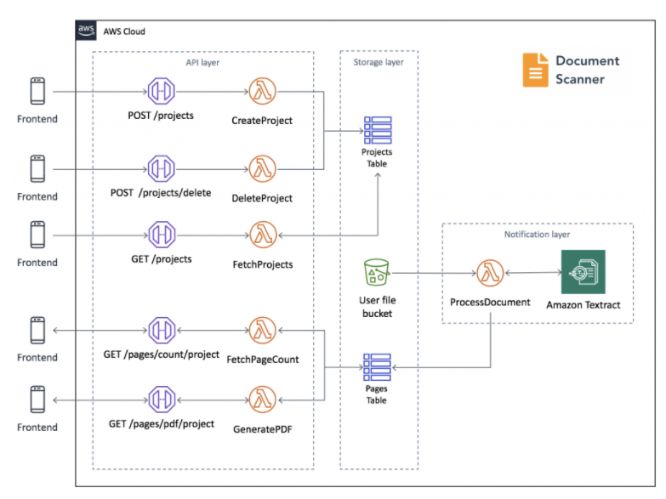
Serverless Back-end
The backend would be built using serverless technologies and would consists of an Amazon API Gateway REST API that would invokes AWS Lambda functions. Amazon Textract would be used to analyze text from uploaded images to an Amazon S3 bucket. Detected text would be stored in Amazon DynamoDB.

Slide 9

Services Used
Amazon Cognito
Amazon API Gateway
AWS Lambda
Amazon DynamoDb
Amazon Simple Storage Service(S3)
Amazon Textract

Slide 10
Snapshots of Completed Work

Slide 11
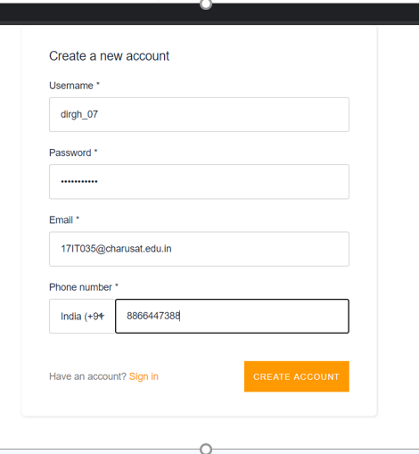
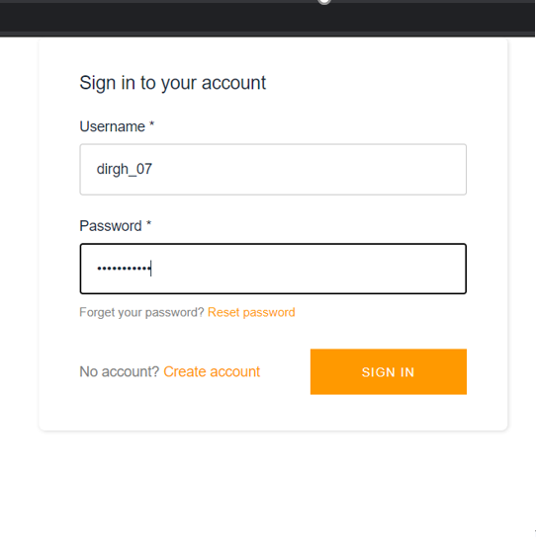

Slide 12
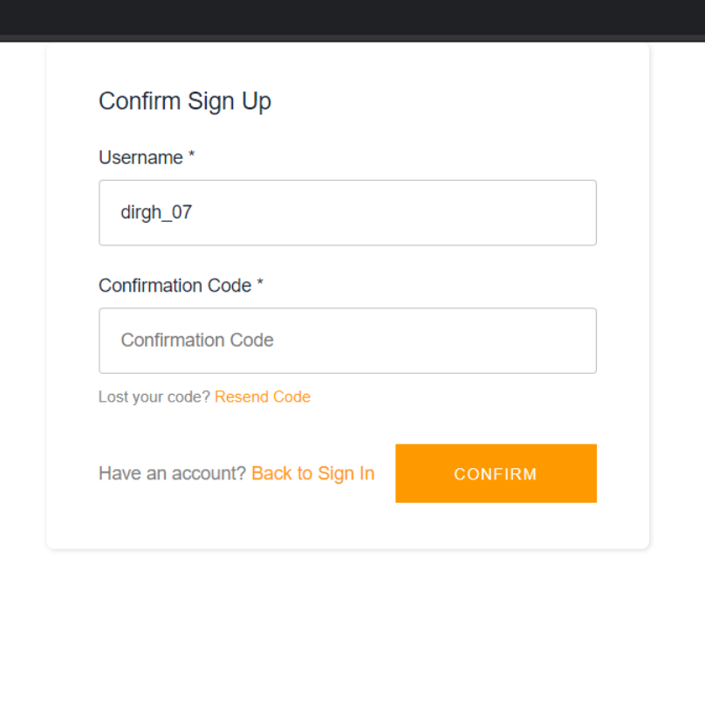
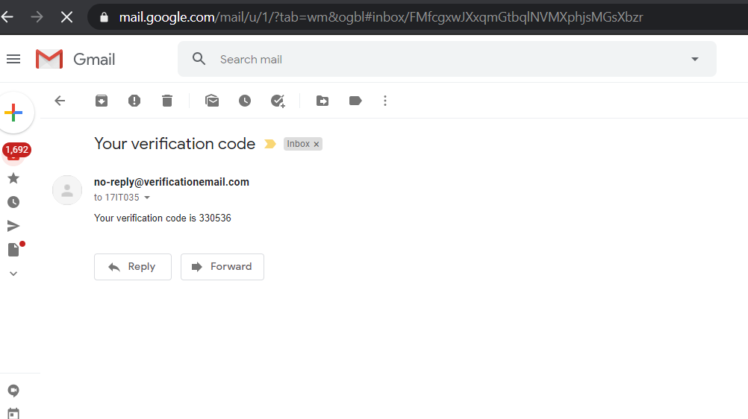

Slide 13
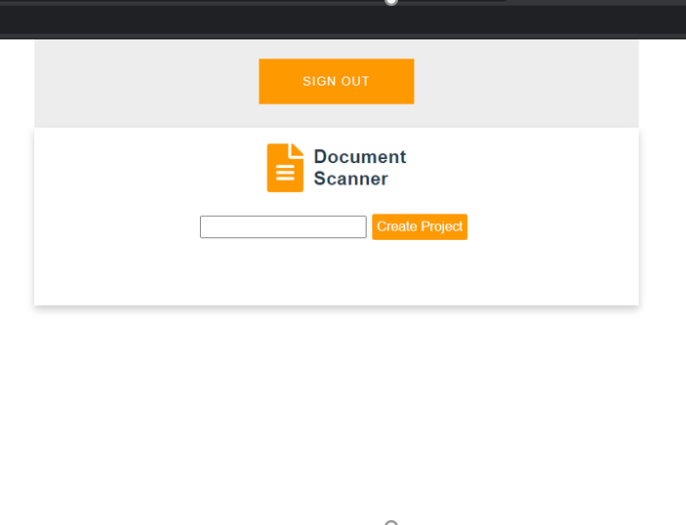
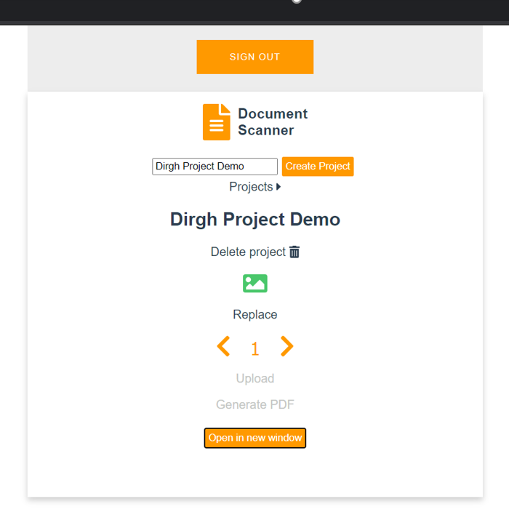

Slide 14
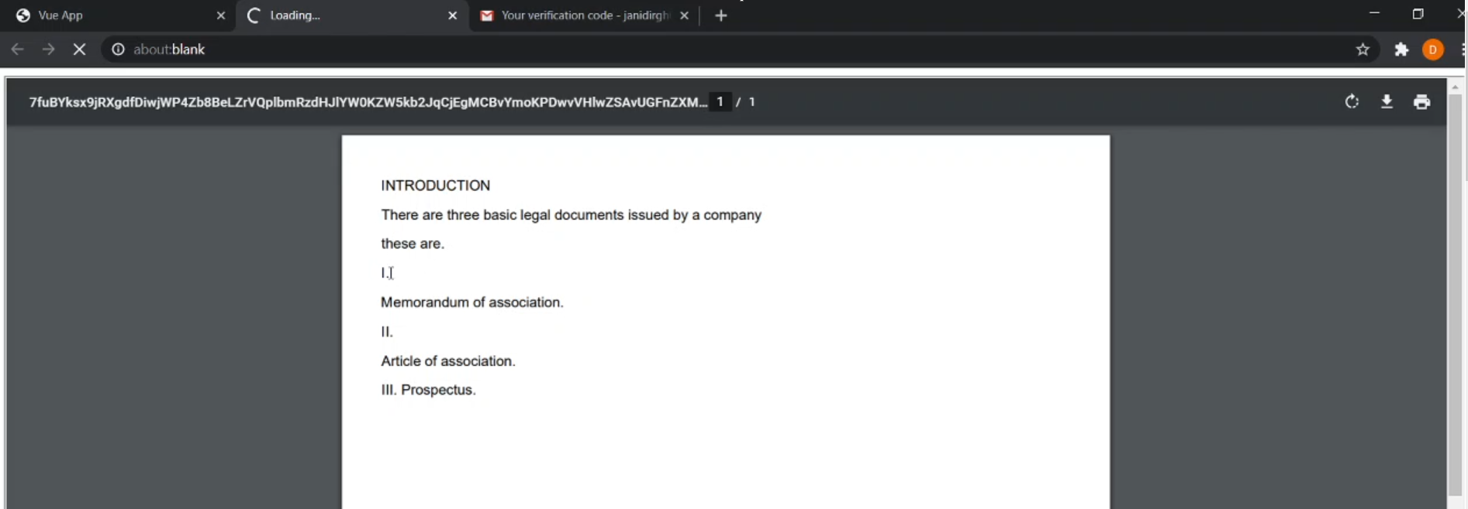

Slide 15

THANK
YOU

